Slide 1

Extreme Gradient Boosting
Brandon Croom
Notes:
Hi. My name is Brandon Croom. Today we’re going to discuss Extreme Gradient Boosting or XGBoost

Slide 2
Agenda
Boosting Refresher
Gradient Boosting
XGBoost
Computational Complexity
GBMs vs XGBoost
Other Implementations
Summary
Notes:
Over the course of the next few minutes we’ll look at the following topic areas as they relate to XGBoost. We’ll first do a quick refresher on boosting algorithms in general to level set on the mathematics. Second we’ll look at how gradient boosting builds on the general boosting methodology. Next we’ll do a deeper dive into XGBoost, the enhancements it makes over gradient boosting and the mathematics behind some of those enhancements. Fourth we’ll look at the computational complexity between gradient boost machines and XGBoost. We’ll then compare use cases for GBMs and XGBoost. As a final topic we’ll look briefly at other implementations that may provide XGBoost some competition. Finally we’ll wrap things up with a brief summary.

Slide 3
Boosting Refresher
Boosting Models
Form of ensemble modeling using a decision tree in which the trees are formed sequentially.
Each sequential tree will use the error of the prior tree as its target and seek to minimize the error of the target variable
Are generally quite accurate in their predictions but run the risk of overfitting
Notes:
Before we get too deep into XGBoost, let’s take a moment to refresh ourselves on boosting. Boosting models are a form of ensemble modeling. Most often the boosting model will first start by utilizing a naïve model, often the mean of the target variable. The error of each instance of the target vector is calculated. This error is then used as the target variable in the next iteration of the boosted model. This process is repeated until some number of trees is reached of some level of error is achieved. These methods are generally greedy in nature and thus it is recommended to set a stopping criterion such as model performance (AKA early stopping) or several stages (such as depth of tree) to prevent overfitting

Slide 4


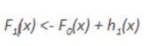
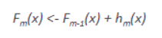
Boosting Refresher
Boosting Notation:
Initial Model:
New Model:
Boosted Version:
Generalized Notation:
Notes:
The mathematical notation for the basic boosting algorithm is as follows:
We define an initial model F0 to predict our target variable Y. This creates the residual (y-F0)
Our new model h1 is fit to the residuals from the previous step
F0 and h1 are combined to give F1, the boosted version of F0. The mean squared error from F1 will be lower than that from F0
We can repeat this process additively until we have minimized the residuals as much as possible.

Slide 5
Agenda
Boosting Refresher
Gradient Boosting
XGBoost
Computational Complexity
GBMs vs XGBoost
Other Implementations
Summary
Notes:
Now let’s move on to Gradient Boosting

Slide 6
Gradient Boosting - Enhancements
Enhances boosting process through:
Learning rate
Sample size
Notes:
Gradient Boosting builds on the general boosting models by adding a learning rate and sample size of each tree used in the boosting process. Gradient boosting adjusts these rates using the gradient descent algorithm, which iteratively optimizes the loss of the model by updating the weights. Here we define loss as the difference between the predicted value and the actual value. The learning rate and sample size help to drive toward a more accurate result

Slide 7
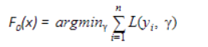
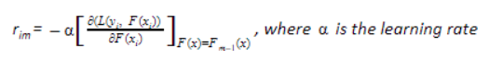
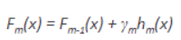
Gradient Boosting – The math
Notation
Define:
Compute the gradient of the loss function
Generalized Notation:
Notes:
The mathematical notation for gradient boosting follows a similar structure to the general boosting algorithm.
First define F0(x) which will be used to initialize the boosting algorithm. We start with F0 defining the minimum of the loss function.
Next define the gradient of the loss function. Here the learning rate is defined as alpha. We iteratively compute the gradient function over the data set. In gradient boosting we fit our model hm(x) on the gradient obtained for each step.
Pulling this all together gives the generalized notation defined.

Slide 8
Agenda
Boosting Refresher
Gradient Boosting
XGBoost
Computational Complexity
GBMs vs XGBoost
Other Implementations
Summary
Notes:
Now let’s look at XGBoost

Slide 9
XGBoost
Started as a research project by Tianqi Chen for the Distributed Machine Learning Community in 2014
Created initially as a terminal application
Became well known in ML competitions after winning the Higgs Machine Learning Challenge
Enhanced version released by Tianqi Chen and Carlos Guestrin in 2016
Notes:
XGBoost started with Tianqi Chen was performing research on variants of tree boosting. After investigating a combination of boosted trees with conditional random field there were no existing capabilities so Chen built his own. Initially XGBoost was designed as a stand alone command line interface program. After attempting the Kaggle Higgs Boson Challenge and performing well XGBoost gained popularity. It was after this 1st place finish that wrappers for various code bases such as Python and R initially started. This has expanded to other languages such as Scala and Java.

Slide 10
XGBoost - Enhancements
Algorithmic
Tree Pruning
Sparsity Aware Split Finding
Continued Training
Systematic:
Parallelization
Cache Aware
Distributed Computing
Out-of-Core Computing
Flexibility
Customized Objective Function
Customized Evaluation Metric
Cross-validation
Built-in Cross-validation
Notes:
XGBoost provides many enhancements over gradient boosting algorithms. These can be categorized into 4 main categorizations:
Algorithmic – how the algorithm works
Systematic – how the algorithm processes data
Flexibility – how the algorithm can be manipulated
Cross-validation – how the algorithm assists with accurate results
Diving deeper into individual items, we’ll start some of the algorithmic enhancements.
Tree Pruning — Pruning is a machine learning technique to reduce the size of regression trees by replacing nodes that don’t contribute to improving classification on leaves. The idea of pruning a regression tree is to prevent overfitting of the training data. The most efficient method to do pruning is Cost Complexity or Weakest Link Pruning which internally uses mean square error, k-fold cross-validation and learning rate. XGBoost creates nodes (also called splits) up to max_depth specified and starts pruning from backward until the loss is below a threshold.
Sparsity Aware Split Finding — It is quite common that the data we gather has sparsity (a lot of missing or empty values) or becomes sparse after performing data engineering (feature encoding). To be aware of the sparsity patterns in the data, a default direction is assigned to each tree. XGBoost handles missing data by assigning them to default direction and finding the best imputation value so that it minimizes the training loss. Optimization here is to visit only missing values which make the algorithm run 50x faster than the naïve method.
Now lets understand some of the systematic enhancements.
Parallelization — Tree learning needs data in a sorted manner. To cut down the sorting costs, data is divided into compressed blocks (each column with corresponding feature value). XGBoost sorts each block parallelly using all available cores/threads of CPU. This optimization is valuable since a large number of nodes gets created frequently in a tree. In summary, XGBoost parallelizes the sequential process of generating trees.
Cache Aware — By cache-aware optimization, we store gradient statistics (direction and value) for each split node in an internal buffer of each thread and perform accumulation in a mini-batch manner. This helps to reduce the time overhead of immediate read/write operations and also prevent cache miss. Cache awareness is achieved by choosing the optimal size of the block (generally 2¹⁶).
Diving deeper into individual items, we’ll start some of the flexibility enhancements.
Customized Objective Function — An objective function intends to maximize or minimize something. In ML, we try to minimize the objective function which is a combination of the loss function and regularization term. Optimizing the loss function encourages predictive models whereas optimizing regularization leads to smaller variance and makes prediction stable. Different objective functions available in XGBoost are: ● reg: linear for regression ● reg: logistic, and binary: logistic for binary classification ● multi: softmax, and multi: softprob for multiclass classification
Customized Evaluation Metric — This is a metric used to monitor the model’s accuracy on validation data. ● rmse — Root mean squared error (Regression) ● mae — Mean absolute error (Regression) ● error — Binary classification error (Classification) ● logloss — Negative log-likelihood (Classification) ● auc — Area under the curve (Classification)
Finally a bit about cross validation.
Built-in Cross-validation — Cross validation is a statistical method to evaluate machine learning models on unseen data. It comes in handy when the dataset is limited and prevents overfitting by not taking an independent sample (holdout) from training data for validation. By reducing the size of training data, we are compromising with the features and patterns hidden in the data which can further induce errors in our model. This is similar to cross_val_score functionality provided by the scikit-learn library.

Slide 11
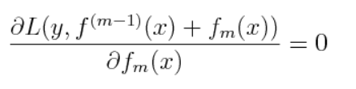
XGBoost - The Math
XGBoost Objective Function:
Notes:
As discussed during the gradient boost section, gradient boost divides the optimization problem into two parts by determining the direction of the step and then optimizing the step length. XGBoost attempts to perform this optimization through a single step. This function must be executed for each x in the data set.
As noted by Chen in the XGBoost paper, the XGBoost objective is a function of functions and “cannot be optimized using traditional optimization methods in Euclidean space”
The optimization methods to get to a Euclidean space function are as follows;

Slide 12
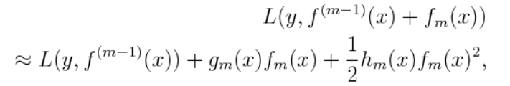
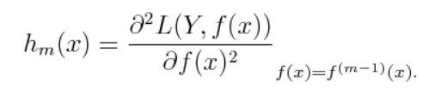
XGBoost - The Math
Taylor expansion:
Hessian:
Notes:
Performing a second order Taylor expansion of the optimizaton function around the current estimate f(m-1), where g_m(x) is the gradient and h_m(x) is the second order derivative or the Hessian at the current estimate:

Slide 13
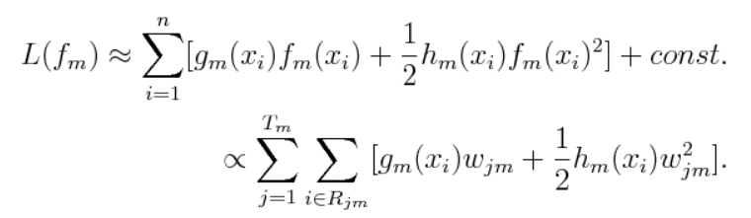
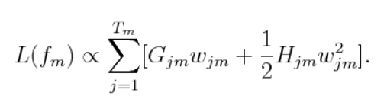
XGBoost - The Math
Rewritten loss function:
Consolidated loss function:
Notes:
Thus we can re-write the loss function as shown above.
Let G_jm represent the sum of the gradient in region j and H_jm equal to the sum of the hessian in region J we can re-write our equation in a consolidated form as shown above

Slide 14
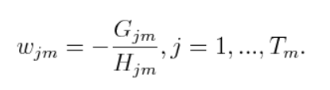
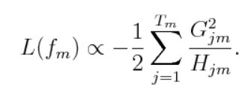
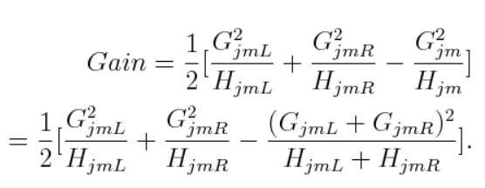
XGBoost - The Math
Optimal Weight:
New Loss function:
Gain Function:
Notes:
Now that the learned structure is fixed, for each region, the optimal weight can be determined as shown.
Thus our new loss function becomes as shown. According to Chen, this is the structure score for the tree. The smaller the score the better the structure. To make each split in the tree a proxy gain function needs to be defined as shown above.

Slide 15
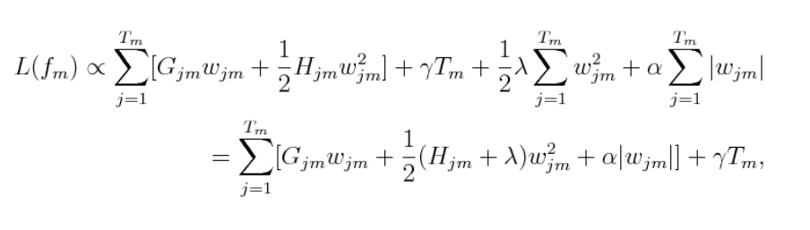
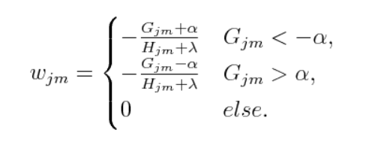
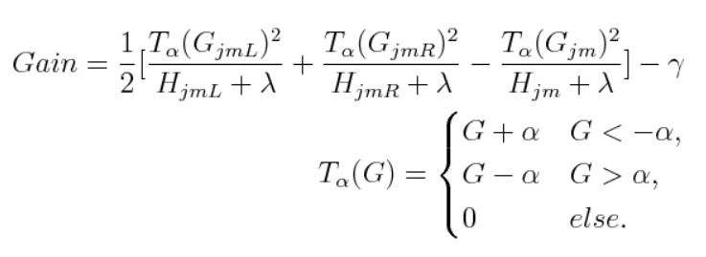
XGBoost – The Math
Final Loss Function:
Notes:
After completing the calculations shown previously, regularization was not taken into consideration. Taking regularization into account provides the final loss function shown above.
Where gamma is the penalization term on the number of terminal notes, alpha and lamba are for L1 and L2 regularization respectively. The weight calculations for region J are calculated as shown and the gain calculation for each split is as shown.

Slide 16
Agenda
Boosting Refresher
Gradient Boosting
XGBoost
Computational Complexity
GBMs vs XGBoost
Other Implementations
Summary
Notes:
Now let’s discuss computational complexity

Slide 17
Computational Complexity
Big O Notation – used to classify algorithms
Based on run time or space requirement growth as input size grows
ML Big O Notation can be difficult
Notes:
As we turn quickly to computational complexity, we’ll look at how XGBoost compares to GBMs. We’ll use the typical notation for algorithm complexity which is called Big O notation. Big O notation takes into account both the time complexity (how fast or slow something is) as well as the space complexity (how much memory is required. Big O only defines an upper bound function for analysis. The letter O is used because the growth rate of a function is also referred to as the order of the function.
With respect to machine learning models, Big O notation can be difficult to determine as it may be implementation dependent, properties of the data may lead to other algorithm or the training time often depends on some parameters passed to the algorithm. Machine learning models are complex and often rely on other algorithms. All of these factors lead to it being difficult to pin down an exact Big O notation for machine learning models.

Slide 18
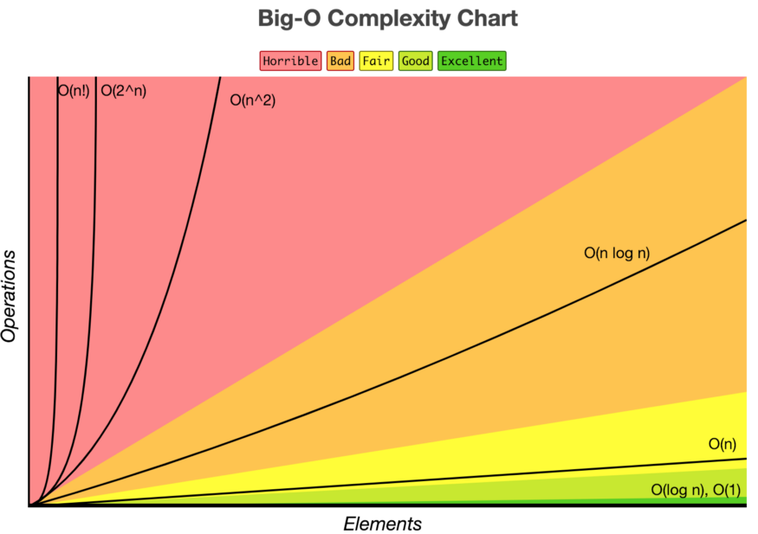
Computational Complexity
Algorithm/model complexity expressed using Big O Notation
Notes:
The chart above gives us a quick view of how to look at Big O notations generally compare. In the typical notation the letter n represents the problem size or number of inputs.
We can see that those algorithms with a factorial big-o typically execute in the “horrible” category. Those that operate on just the number of elements or even better the log of the number of inputs perform best

Slide 19
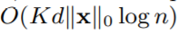
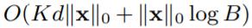
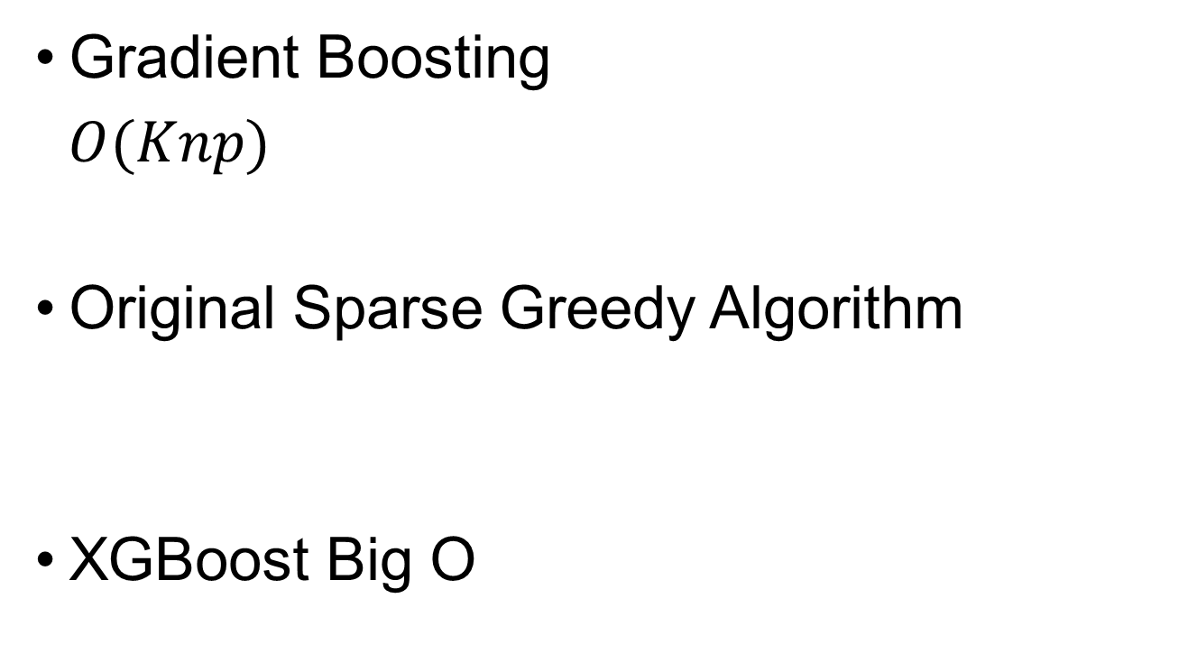
Computational Complexity
Gradient Boosting
$O(Knp)$
Original Sparse Greedy Algorithm
XGBoost Big O
Notes:
There have been estimates of Big O notation for gradient boosting. We can see that in general gradient boosting has a Big O notation of
K the total number of trees times
n, the number of training samples times
P, the number of features
According to Chen’s paper on XGBoost, the initial greedy algorithm was defined as shown above were:
K = total number of trees
D = maximum depth of the trees
||X|| = number of non-missing entries in the training data
Building on the greedy algorithm and changes in XGBoost implementation, Chen states that the big O notation for XGBoost is
K times d time {{X|| + |x| log B, where B is the maximum number of rows in each block structure
The original sparse greedy algorithm doesn't use block storage. Thus to find the optimal split at each node, you needed to re-sort the data on each column. This ends up incurring a time complexity at each layer that is very crudely approximated by O(∥x∥0logn)
Multiplying by K trees and d layers per tree gives you the original O(Kd∥x∥0logn) time complexity.
On the other hand, with the block structure, since the data is already pre-sorted by every column at the start, you don't need to re-sort at each node, as long as you keep track at each node of which data points have made it to that node. As the authors note, this brings the complexity down to O(Kd∥x∥0) (since the optimal splits at each layer can now be found via a single scan over the block) plus whatever the cost of preprocessing is (the authors claim it to be O(∥x∥0logn)O(‖x‖0log⁡n), which makes sense).

Slide 20
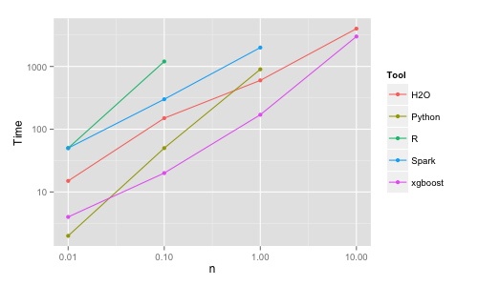
Computational Complexity
Notes:
This speed increases of XGBoost have also been benchmarked multiple times. Szilard Pafka performed some objectimve benchmarks, in 2015, comparing XGBoost performance to other implementations of gradient boosting and bagged decision trees. The graph above is from that analysis. His results showed that XGBoost was almost always faster than the other benchmark implementations form R, Python, Spark and H20.

Slide 21
Agenda
Boosting Refresher
Gradient Boosting
XGBoost
Computational Complexity
GBMs vs XGBoost
Other Implementations
Summary
Notes:
Over the course of the next few minutes we’ll look at the following topic areas as they relate to XGBoost. First we’ll do an overview of gradient boosting in general to level set the mathematics behind the algorithms. Next we’ll cover the specifics around XGBoost and how it compares to general gradient boosting algorithms. Third we’ll look at the computational speed comparisons between gradient boost and xgboost. Finally we’ll close with an overview of other implementations of XGBoost that exist

Slide 22
GBM vs. XGBoost
GBM has a broader application
Both need to calculate gradient at current estimate
XGBoost also needs to calculate a hessian
Requires objective function to be twice differentiable
GBM only requires a differentiable loss function

Slide 23
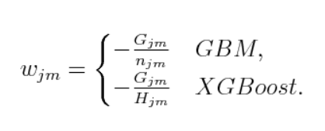
GBM vs. XGBoost
XGBoost is faster
GBM weight calculation is the average value of the gradients
XGBoost weight calculation is the sum of gradients scaled by the sum of hessians
Notes:
Since the XGBoost weight is known as a Newton step, which naturally has a step length of 1 no line search is necessary for XGBoost

Slide 24
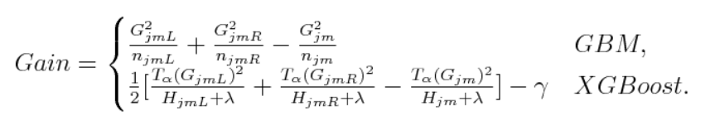
GBM vs. XGBoost
XGBoost provides more regularization options:
Can regularize L1 and L2
Penalize on number of leaf nodes
Notes:
As a reminder, L1 regularization typically use Lass regression and L2 regularization typically uses Ridge Regression

Slide 25
GBM vs. XGBoost
XGBoost provides more randomization:
GBM provide only one level of column sampling
XGBoost provides two levels of column sample:
ByTree
ByLevel
Notes:
In the SciKit Learn implementation there is more randomization. In other modules that may be different.

Slide 26
Agenda
Boosting Refresher
Gradient Boosting
XGBoost
Computational Complexity
GBMs vs XGBoost
Other Implementations
Summary
Notes:
Over the course of the next few minutes we’ll look at the following topic areas as they relate to XGBoost. First we’ll do an overview of gradient boosting in general to level set the mathematics behind the algorithms. Next we’ll cover the specifics around XGBoost and how it compares to general gradient boosting algorithms. Third we’ll look at the computational speed comparisons between gradient boost and xgboost. Finally we’ll close with an overview of other implementations of XGBoost that exist

Slide 27
Other Implementations
LightGBM
Framework released by Microsoft in 2017
Highly efficient, scalable framework
Supports multiple algorithms
Fast and memory efficient
Uses Gradient based One-Side Sampling
Handles Categorical features efficiently
CatBoost
Framework released by Yandex Technology in 2017
Open source framework for gradient boosting decision trees
Handles Categorical features efficiently
Does not support sparse matrices
Longer runtimes on data sets with large number of numerical features
Notes:
There are other implementations of gradient boosting that are starting to compete with XGBoost. The first is LightGBM. LightGBM is a framework released by Microsoft in 2017. It’s a highly efficient and scalable framework that supports multiple algorithms. LightGBM is evidenced to be several times faster than existing implementations of gradient boosting trees, due to its fully greedy tree-growth method and histogram-based memory and computation optimization. It also has a complete solution for distributed training, Light GBM handles categorical features very well, especially compared to XGBoost.
Another implementation of gradient boosting is CatBoot. CatBoost was released by Yandex Technology in 2017 to the open source community. CatBoost handles categorical features very efficiently. Some drawbacks identified in CatBoost are that it does not currently support sparse matrices and it can have longer runtimes on data sets containing a large number of numerical features.
Multiple comparisons are emerging between XGBoost, LightGBM and CatBoost, largely in an effort to benchmark which implementation is faster. The results vary depending upon the resource. For example, looking at the CatBoost webpage will show that CatBoost outperforms LightGBM and XGBoost consistently. Other analysis shows mixed results based on the data sets and parameters used in the analysis.
All of this leads to needing to understand the algorithms available and choosing the one that is best fit to solve the problem.

Slide 28
Agenda
Boosting Refresher
Gradient Boosting
XGBoost
Computational Complexity
GBMs vs XGBoost
Other Implementations
Summary
Notes:
Now let’s wrap things up with a quick summary

Slide 29
Summary
Provided a background on boosting techniques
Deep dive into XGBoost
Evaluated computational complexity
Compared differences in GBMs and XGBoost
Brief overview of other alternatives
Notes:
Over the course of this presentation, we’ve provided background information on boosting techniques, both for general boosting and gradient boosting. We’ve done deep into XGBoost looking at the enhancements that have been made in the algorithm to make it more efficient and flexible when compared to gradient boosting. We’ve also looked at the math behind XGBoost. We’ve taken a quick look at the computational complexity as it relates to XGBoost. We’ve compared differences between GBMs and XGBoost and finally we looked at alternative frameworks that compete with XGBoost.
All in all I hope that you’ve gotten a good understanding of XGBoost. Thank you for your time.

Slide 30
References
https://opendatascience.com/xgboost-is-machine-learnings-captain-america/
https://arxiv.org/pdf/1603.02754.pdf
https://medium.com/sfu-cspmp/xgboost-a-deep-dive-into-boosting-f06c9c41349
https://www.analyticsvidhya.com/blog/2018/09/an-end-to-end-guide-to-understand-the-math-behind-xgboost/
https://en.wikipedia.org/wiki/XGBoost
https://homes.cs.washington.edu/~tqchen/2016/03/10/story-and-lessons-behind-the-evolution-of-xgboost.html
read://https_machinelearningmastery.com/?url=https%3A%2F%2Fmachinelearningmastery.com%2Fgentle-introduction-xgboost-applied-machine-learning%2F
https://towardsdatascience.com/boosting-algorithm-xgboost-4d9ec0207d
https://medium.com/hackernoon/boosting-algorithms-adaboost-gradient-boosting-and-xgboost-f74991cad38c
https://medium.com/hackernoon/gradient-boosting-and-xgboost-90862daa6c77
https://opendatascience.com/gradient-boosting-and-xgboost/
https://homes.cs.washington.edu/~tqchen/pdf/BoostedTree.pdf
https://github.com/szilard/benchm-ml
https://towardsdatascience.com/catboost-vs-light-gbm-vs-xgboost-5f93620723db
https://medium.com/@hanishsidhu/whats-so-special-about-catboost-335d64d754ae
https://www.microsoft.com/en-us/research/project/lightgbm/
https://catboost.ai/
Notes:
All in all I hope that you’ve gotten a good understanding of XGBoost.
The slide provides a list of references for this presentation.
Thank you for your time.

Slide 31
Video Link
https://vimeo.com/442735566

